Slide 1
Software Project Management
Project planning
Dr. D Evangelin geetha
Associate professor
Department of master of computer applications
Ramaiak institute of technology
Bangalore - 560054

Slide 2
Introduction
Step wise project planning
  Step 0: Select project
  Step 1: Identify project scope and objectives
  Step 2: Identify project infrastructure
  Step 3: Analyze project characteristics
  Step 4: Identify project products and activities
  Step 5: Estimate effort for each activity
  Step 6: Identify activity risks
  Step 7: Allocate resources
  Step 8: Review/Publicize plan
  Steps 9 and 10: Execute plan/Lower levels of planning

Slide 3
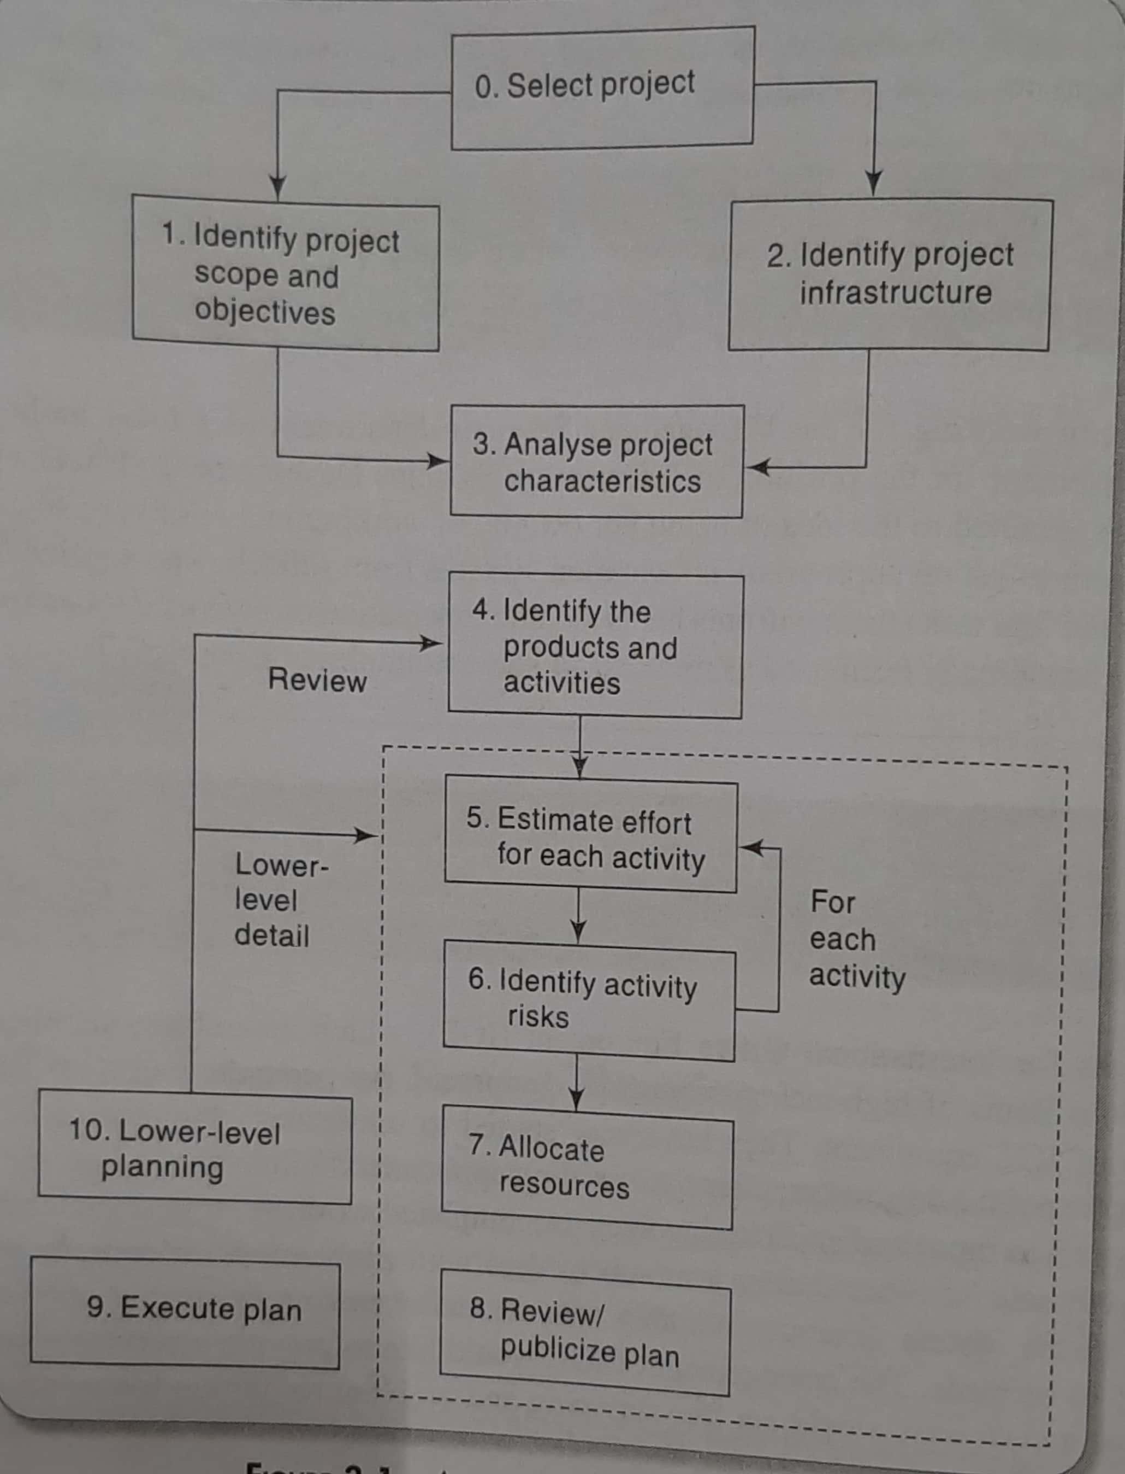
Step wise project planning

Slide 4
Step 0: select project
Outside the main project planning process
Project portfolio management

Slide 5
Step 1: Identify project scope and objectives
  1.1: Identify objectives and practical measures of the effectiveness in meeting those objectives
  1.2: Establish a project authority
    Single overall project authority needs to be established
  1.3: stakeholder analysis – identify all stakeholders in the project and their interests

Slide 6
Step 1: Identify project scope and objectives
  1.4: Modify objectives in the light of stakeholder analysis
    Adding new features to the system
    Drawback: system size may be increased and the original objectives obscured
  1.5: Establish methods of communication with all parties

Slide 7
Step 2: Identify project infrastructure
2.1: identify relationship between the project and strategic planning
  Technical framework within which the proposed new systems are to fit
  Hardware and software standards
  Documentation of Technical strategic decisions – part of enterprise architecture process

Slide 8
Step 2: Identify project infrastructure
2.2: identify installation standards and procedures
  Define development procedures
  SDLC – documentation
  Change control and configuration management standards
  Quality checks
  Measurement programme
  Project planning and control standards – project manager
    Recording hours spent by team members

Slide 9
Step 2: Identify project infrastructure
2.3 Identify project team organization
  Developers and business analysts in different groups
  Groups based on domain – Web based different from database projects

Slide 10
Step 3: Analyze project characteristics
3.1 – distinguish the project as either objective or product driven
3.2 – analyze other project characteristics (including quality – based ones)
3.3 – identify high level project risks
3.4 – Take into account user requirements concerning implementation
3.5 - Select development methodology and life-cycle approach
3.6 – Review overall resource estimates

Slide 11
Step 4: Identify project products and activities
4.1: Identify and describe project products
  Products handed over to the client at the end of the project – Deliverables
  Intermediate products
  Product Breakdown Structure (PBS)
  A product could be a person
  Product Description contains
    Name/identity of the product
    Purpose of the product
    Derivation of the product
    Composition of the product
    Form of the product
    Relevant standards
    Quality criteria that define whether the product is acceptable

Slide 12
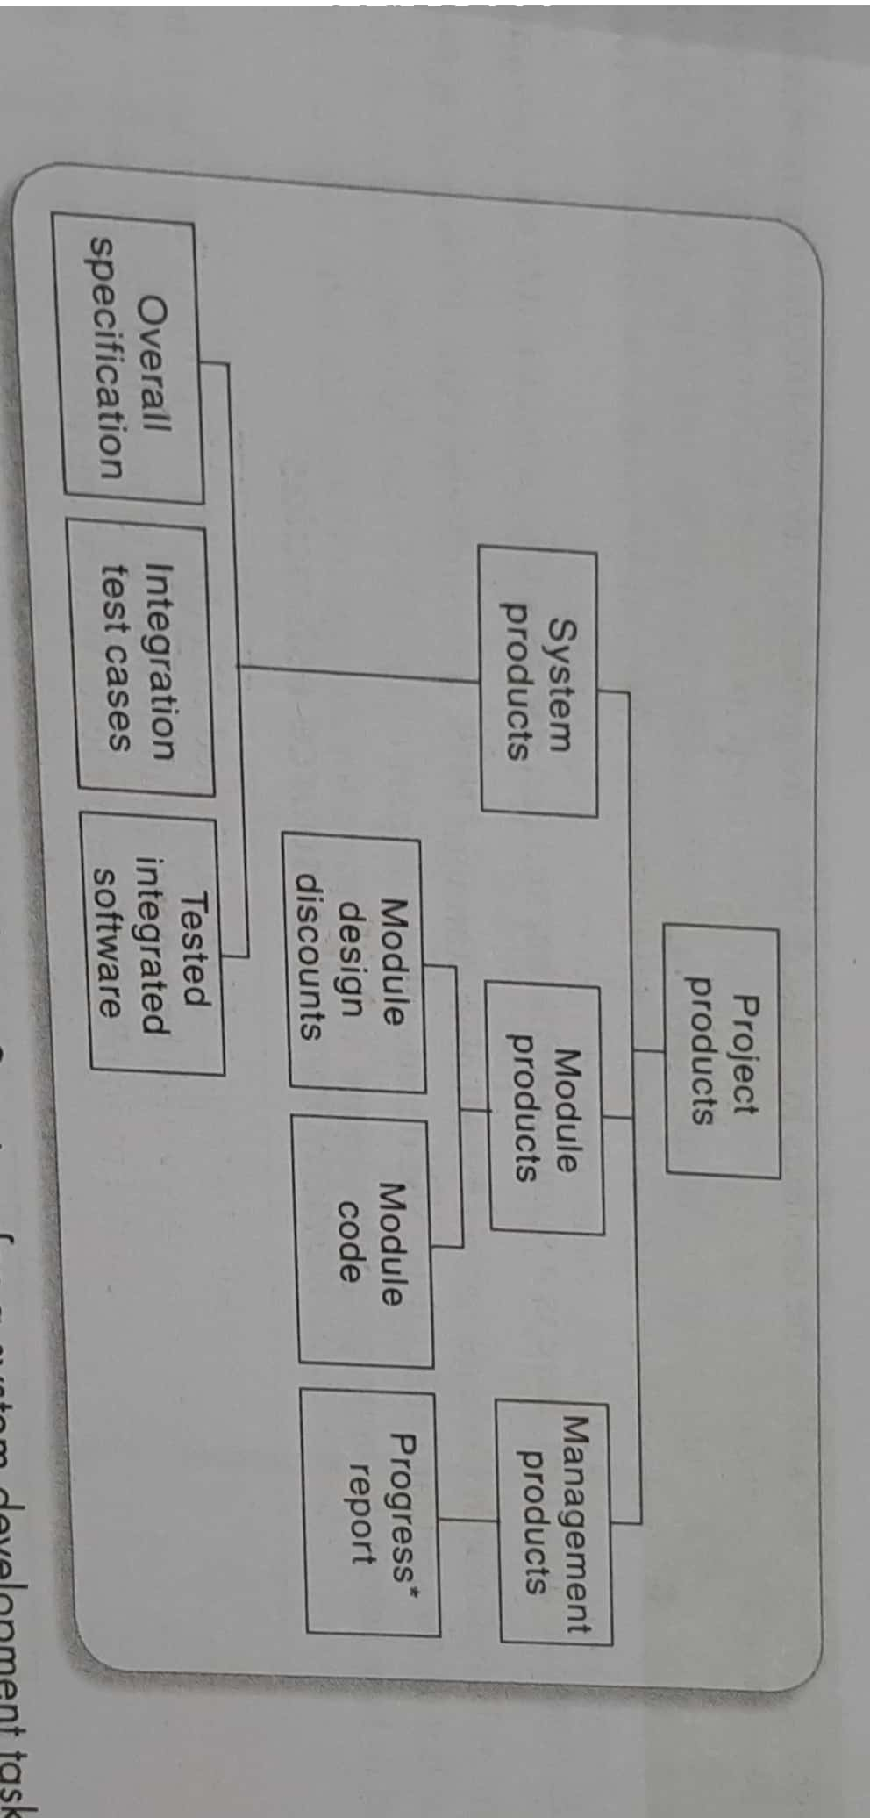
Product breakdown structure

Slide 13
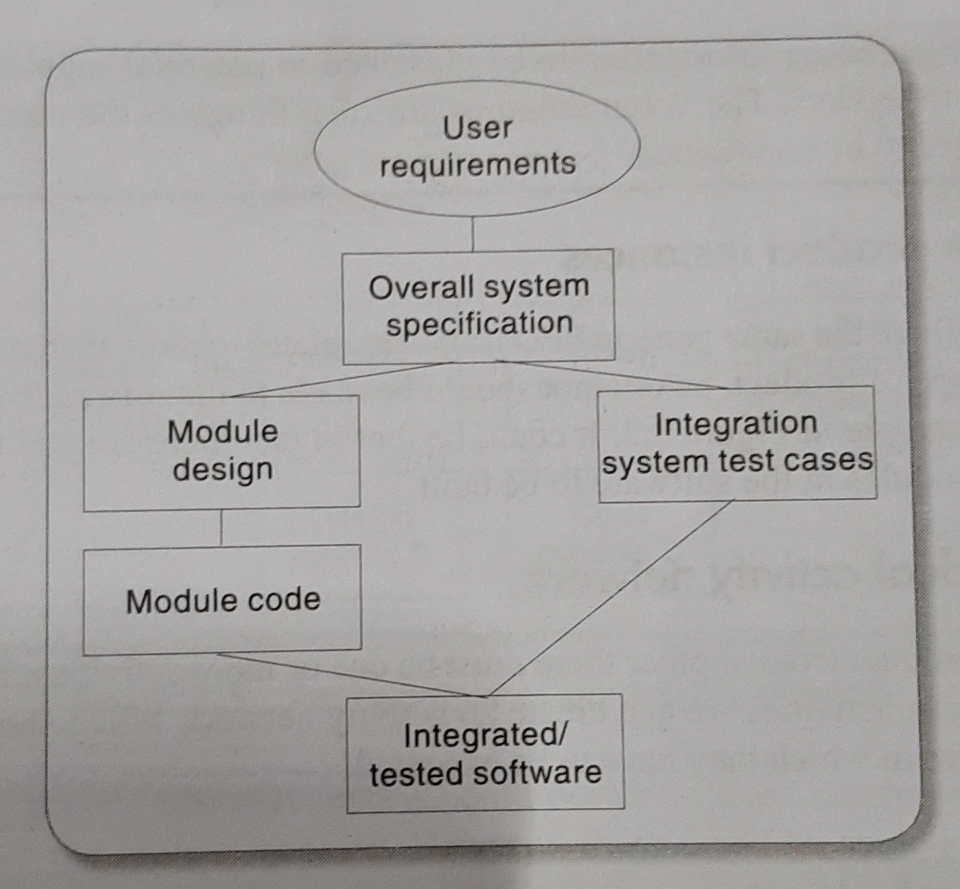
Step 4: Identify project products and activities
4.2: Document generic product flows
  Product Flow Diagram

Slide 14
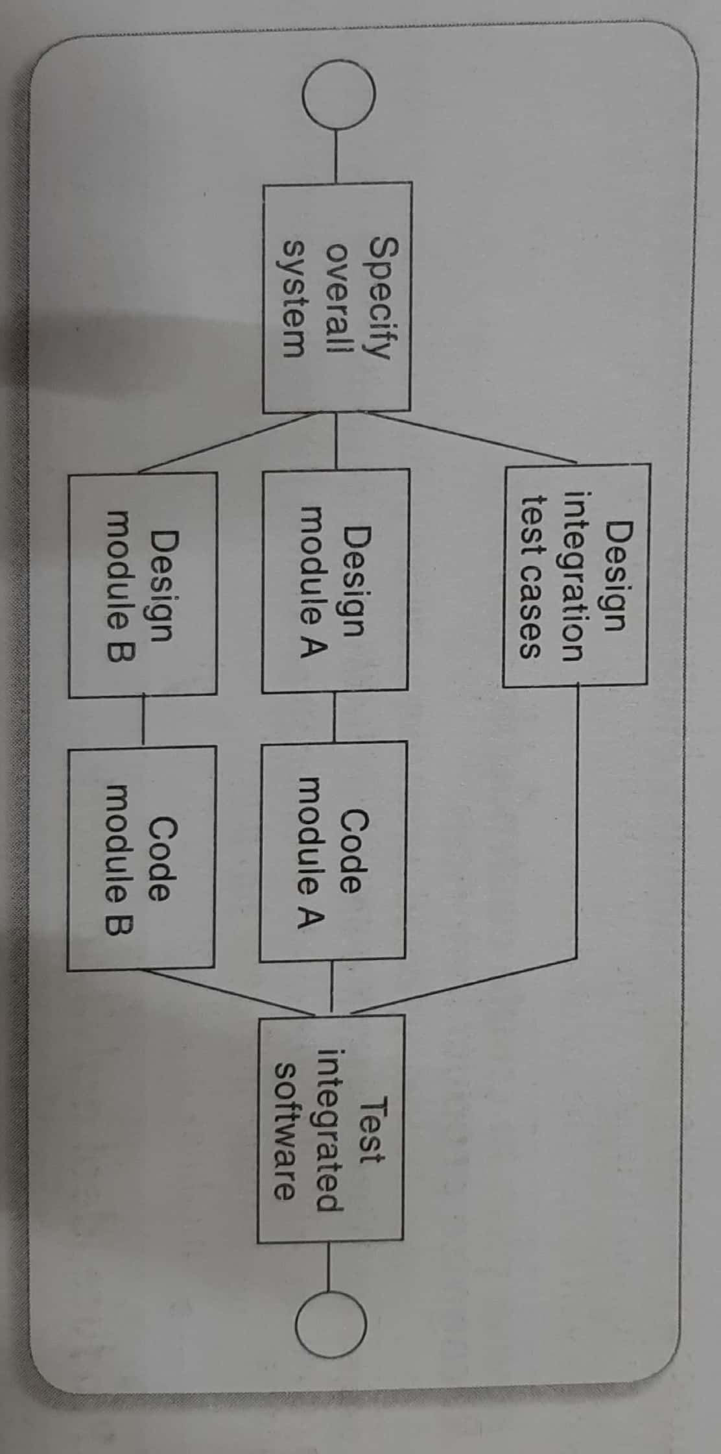
Step 4: Identify project products and activities
4.3: Recognize product instances
4.4: Produce ideal activity network

Slide 15
Step 4: Identify project products and activities
4.5: Modify the ideal to take into account need for stages and checkpoints

Slide 16
Step 5: Estimate effort for each activity
5.1: Carry out bottom-up estimates
  Probable elapsed time and Non-staff resources needed
    need to estimate staff effort, time for each activity, and other resources
  Different estimation methods may be used depending on the type of activity.
  Effort is the amount of work that needs to be done.
  Elapsed time is the time between the start and end of a task
    E.g. three staff for 2 full days each - effort is 3x2 = 6 days
    Elapsed time is 2 days
  Overall bottom-up estimate – the individual activity estimates of effort to be summed up
  Calculate the overall duration of project based on the estimated time for each activity in the activity network.

Slide 17
Step 5: Estimate effort for each activity
Step 5.2: Revise plan to create controllable activities
  Long activities make a project difficult to control
  need to break a task into a series of manageable sub-tasks
  Activities take individually very less time can be merged together
    E.g Training programme
  Suggestion: try to make activities about the length of the reporting period used for monitoring and controlling the project

Slide 18
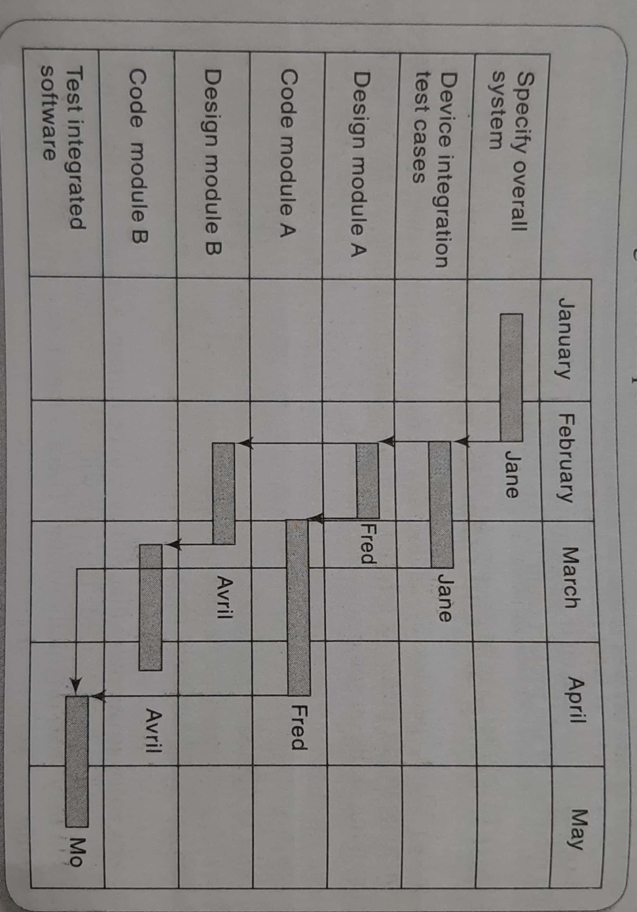
Gantt chart

Slide 19
Step 6: Identify activity risks
6.1: Identify and quantify activity-based risks
  E.g. design of a component
6.2: Plan risk reduction and contingency measures where appropriate
  Contingency plans
    E.g. contract staff
6.3: Adjust overall plans and estimates to take account of risks
  E.g. New programming language

Slide 20
Step 7: Allocate resource
7.1: Identify and allocate resources
  type of staff needed for each activity
  staff availabilities are identified
  staff are provisionally allocated to task
7.2 Revise plans and estimates to take into account resource constraints
  staffing constraints
  staffing issues
  Gantt chart

Slide 21
Step 8: Review/Publicize plan
8.1: Review quality aspects of the project plan
  Task needs quality review, when it is completed
  Each task should have quality criteria
8.2: Document plans and obtain agreement

Slide 22
Steps 9 and 10: Execute plan/Lower levels of planning
Detailed planning of the later stages need to be delayed

